Slide 1
EPP
Europaperpack LTD.
www.EuroPaperPack.com

Slide 2
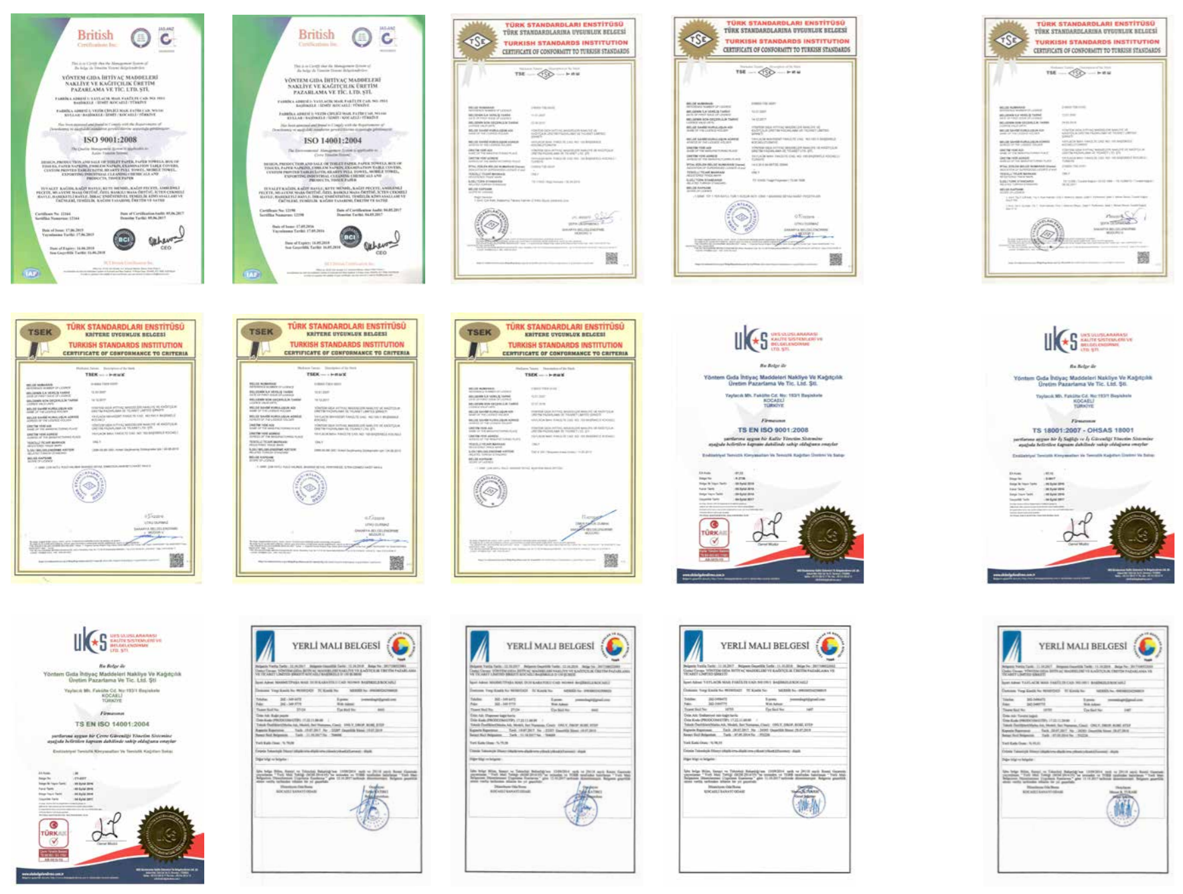
1
HIGH
QUALTY
Certificate
Sertifikalar
KALİTE STANDARTLARINA UYGUN, ÇEVRE DOSTU ÜRÜNLER
WE ARE MANUFACTURING PRODUCTS ACCORD WITH QUALITY STANDARDS AND ENVIRONMENT FRIENDLY
>
www.EuroPaperPack.com

Slide 3
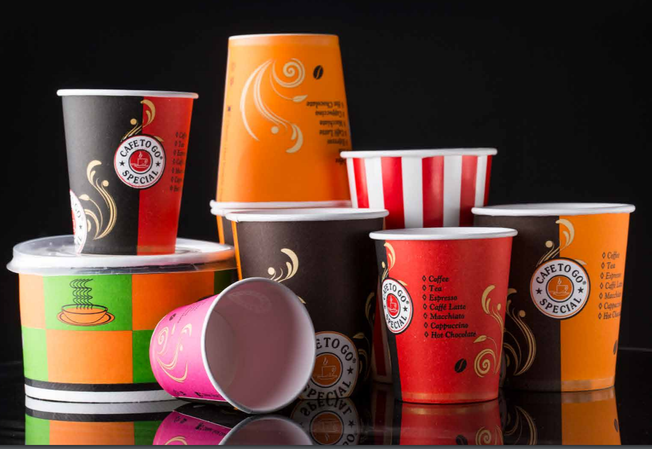
2
YÜKSEK KALİTELİ ÜRÜNLER
SÜREKLİ GELİŞİM VE INOVASYON
HIGH QUALITY PRODUCTS
CONTINUOUS DEVELOPMENT AND INNOVATION
CUP
Bardaklar
>

Slide 4
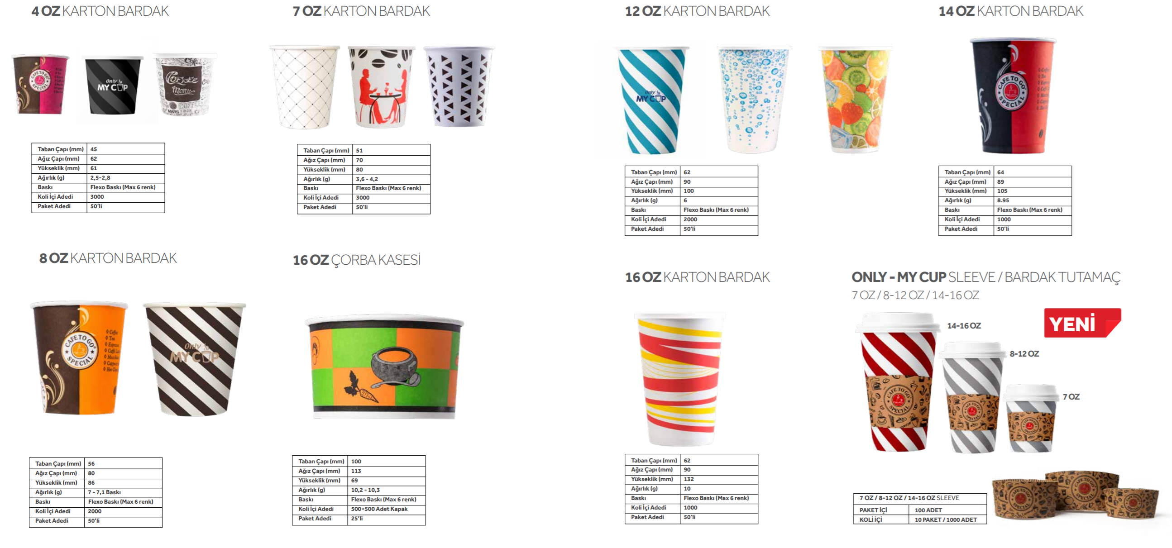
3
CUP
Bardaklar
>
www.EuroPaperPack.com

Slide 5
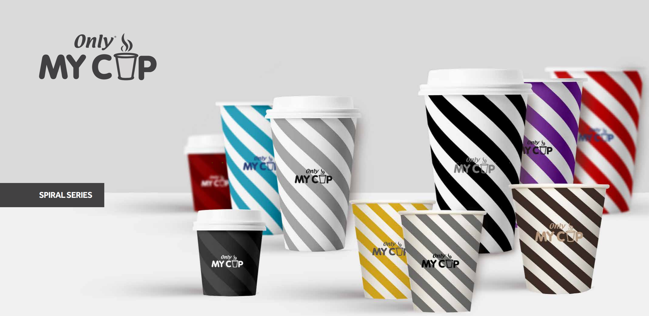
4
CUP
Bardaklar
>

Slide 6
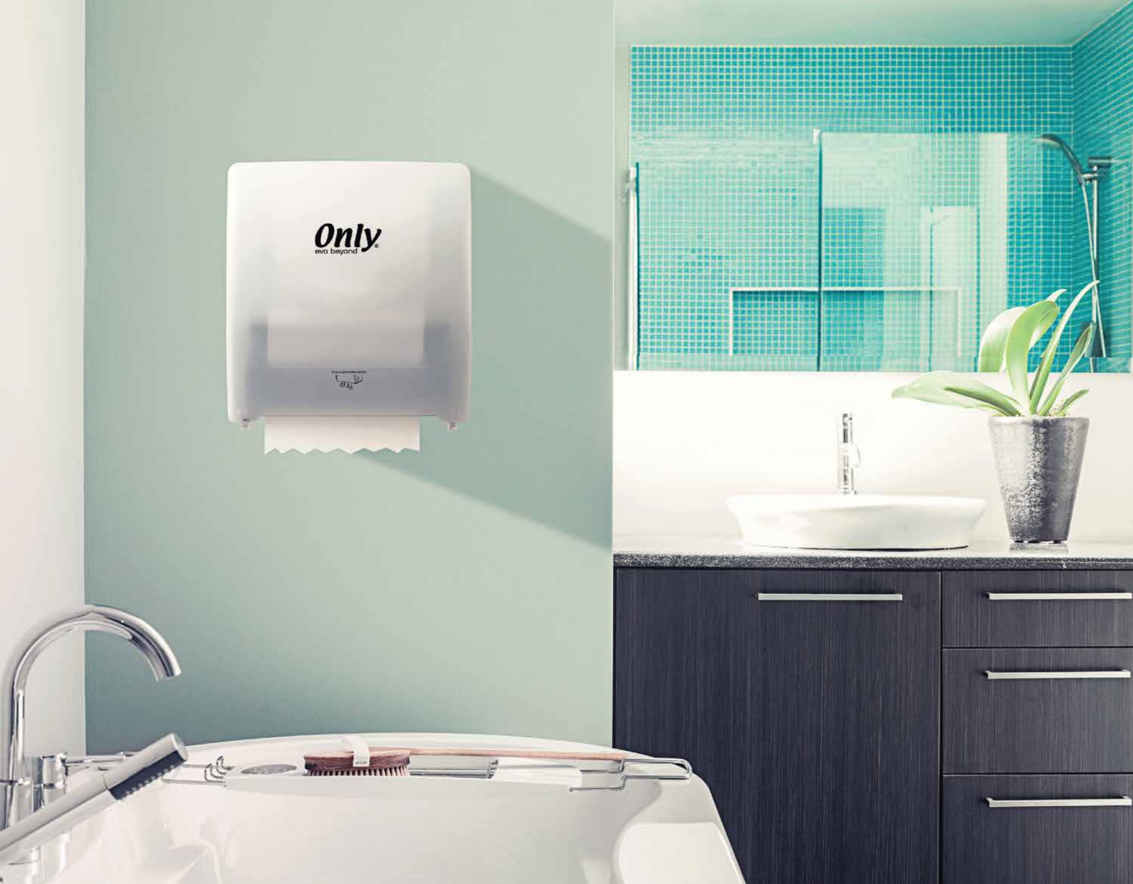
5
ENERJİSİNİ SİZDEN ALIR
IT TAKES ITS
ENERGY FROM YOU
EVO BEYOND
DISPENSER
>

Slide 7
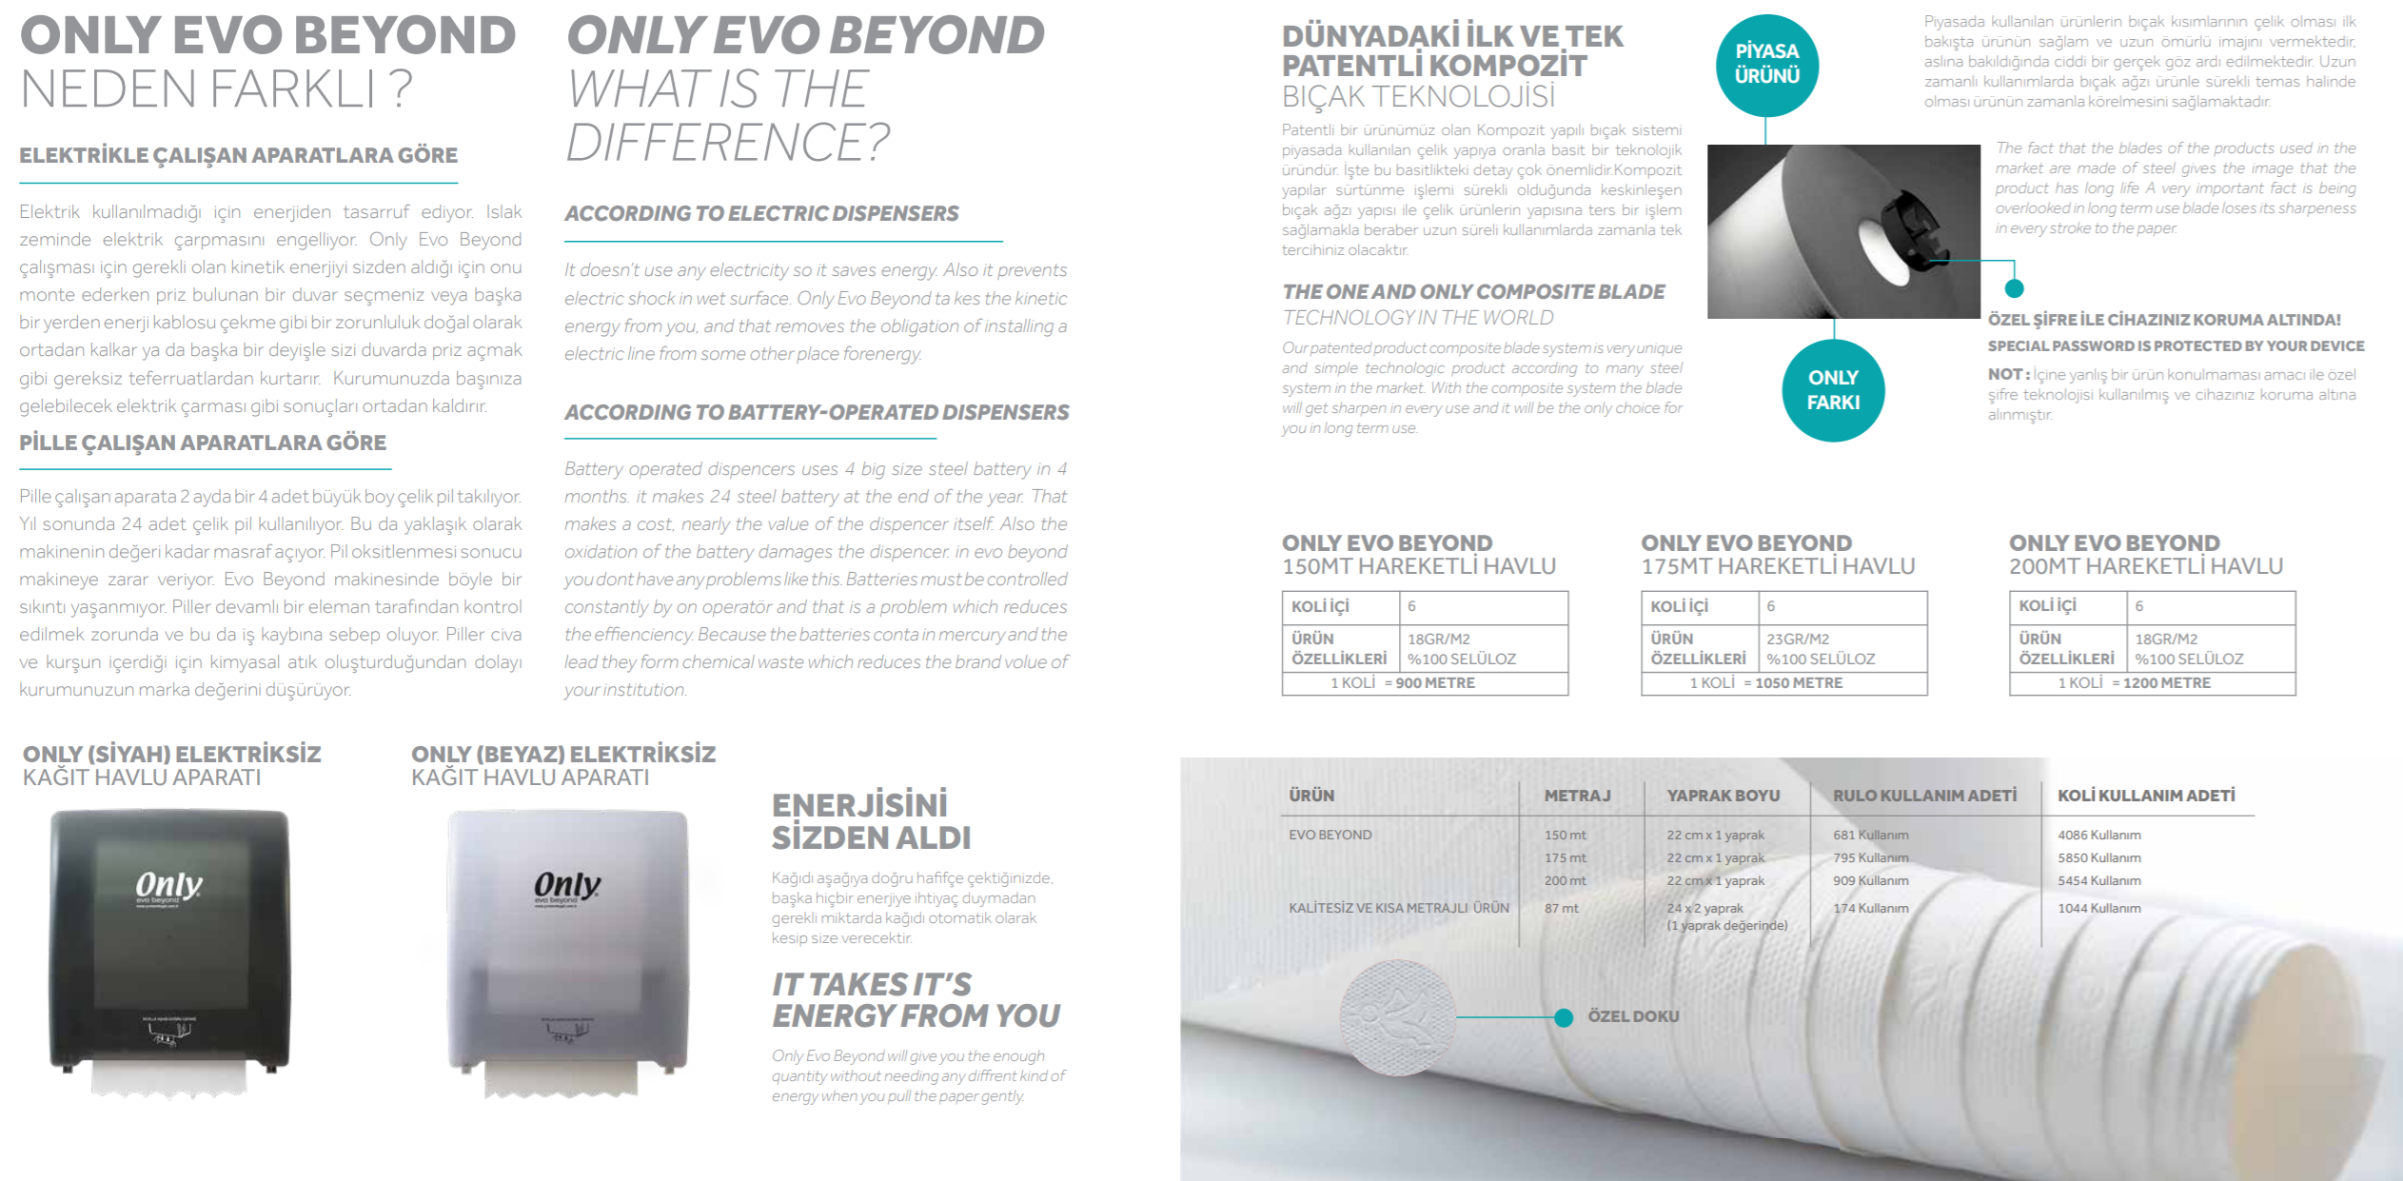
6
EVO BEYONDTHE FIRST COMPOSITE BLADE, PATENTED PRODUCT IN THE WORLD
>
www.EuroPaperPack.com

Slide 8
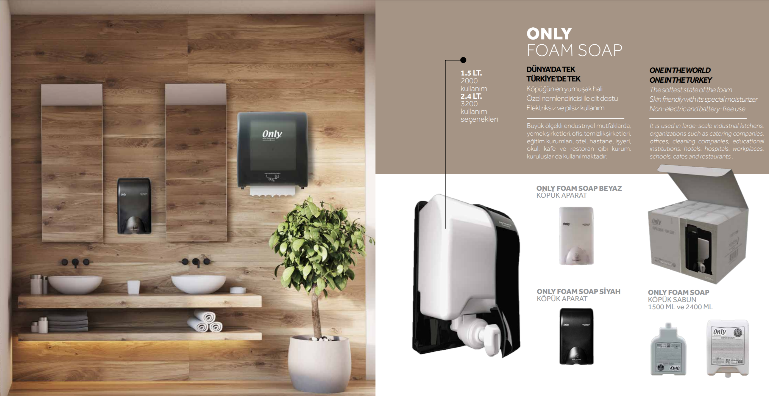
7
FOAM SOAP
KÖPÜKLÜ SABUN ve APARATI
>

